Slide 1
Predictive Analysis can help you Combat Employee Attrition! Learn How

Slide 2
Agenda
At the end of the session, you will be able to understand:
BI vs BA
Types of Analytics
Why Predictive Analytics?
Domains where predictive analysis is creating magic
Benefits Which you can gain with HR Analytics
Real Time examples on HR Analytics
Hands on

Slide 3
Business Intelligence Vs Business Analytics

Slide 4
BI Vs BA
Before we go ahead, lets understand difference between BI and BA
Business Intelligence
Business Analytics
WHAT is happening to your business = Business Intelligence (For Visibility) Data-warehousing, visualizations, Dashboards--> Enabler of BI
WHY it is happening, WHAT WILL likely happen in future = Business Analytics (For Investigation, Prediction & Prescription)
Data analytics, Data sciences --> Enabler of Business analytics
BI(What) --> Diagnostic analytics(Why) --> Predictive analytics(What will) --> Predictive analytics(Next best action)
is the path smarter organizations adopt and rightly so!

Slide 5
Types of Analytics?

Slide 6
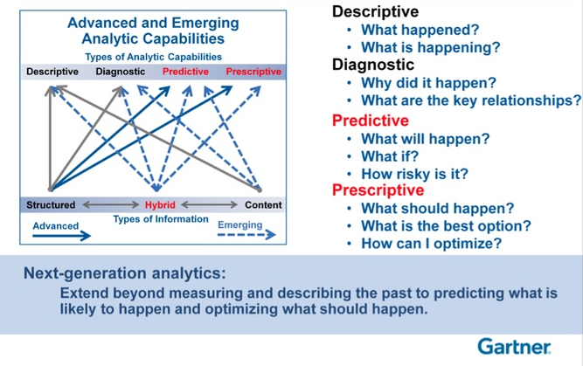
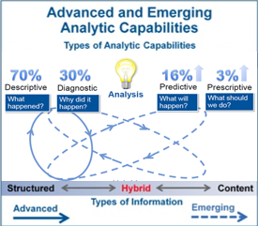
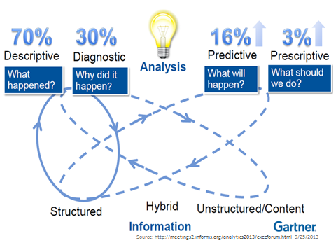
Next-Generation Analytics

Slide 7
What is Predictive Analytics?

Slide 8
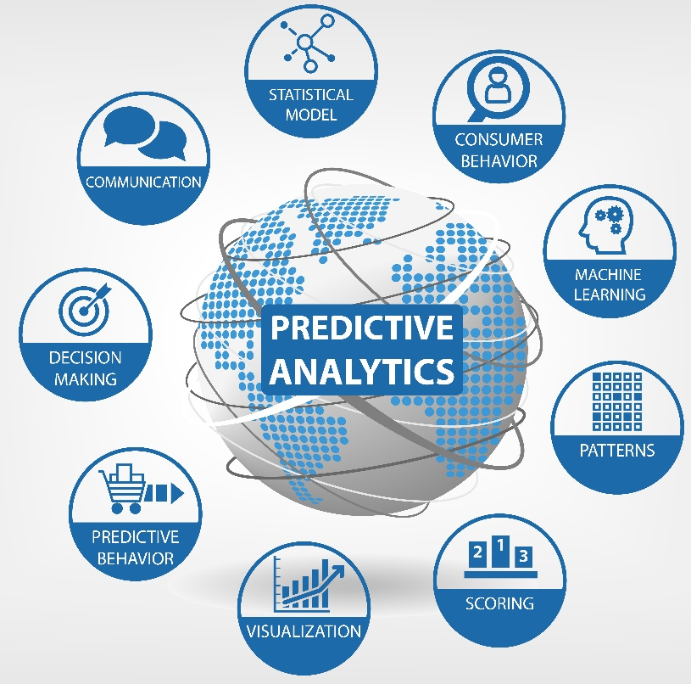
Predictive Analytics
Predictive analytics is the analysis of data by using statistical algorithms and machine-learning techniques to identify the likelihood of future outcomes based on historical data.

Slide 9
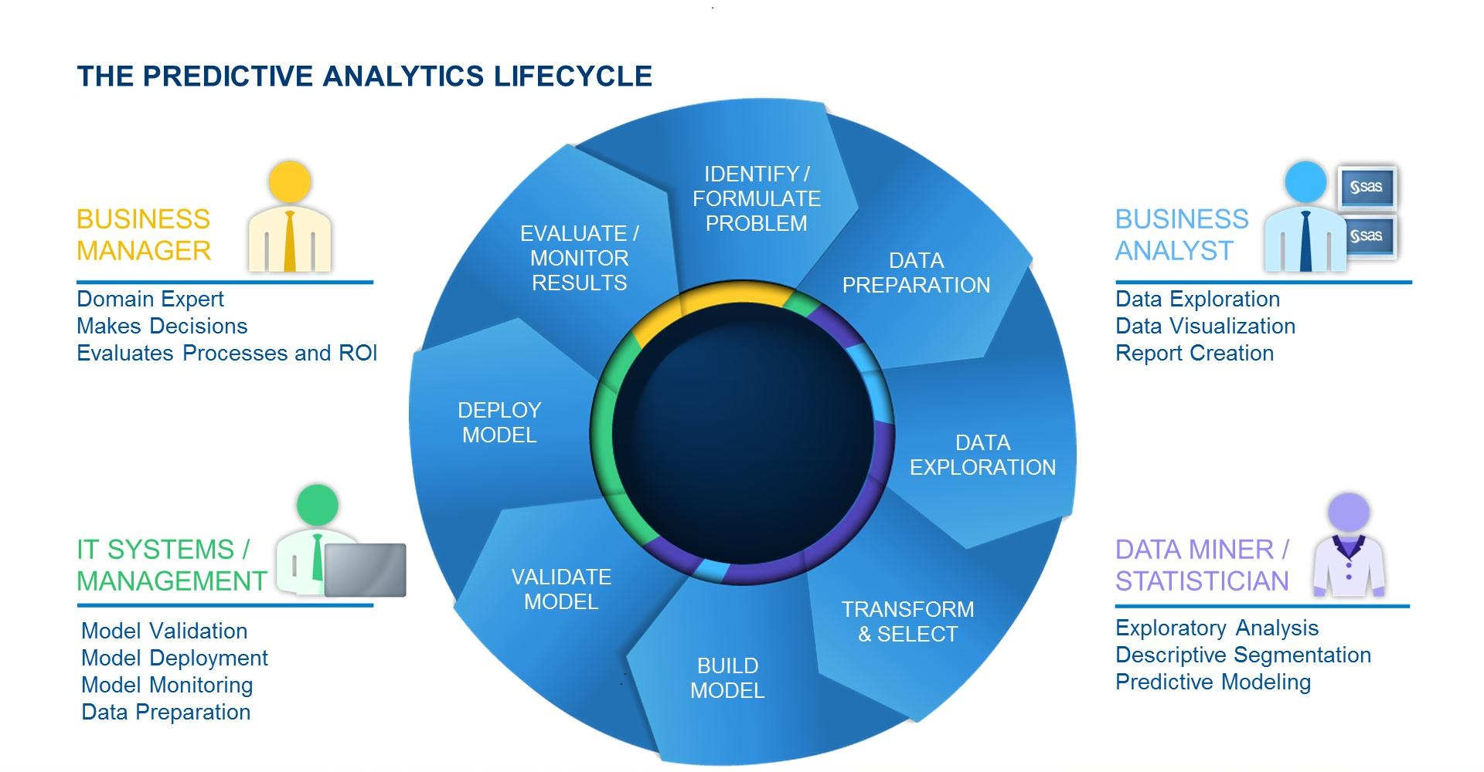
Predictive Analytics Lifecycle
Source: blogs.sas.com

Slide 10
Why Predictive Analytics?

Slide 11

Only Analytics Is Not Enough!
Predictive analytics is a game-changer — it’s like “Moneyball” for… money.

Slide 12
Forbes Says
The top objective for between two-thirds and three-quarters of executives is to develop the ability to model and predict behaviours to the point where individual decisions can be made in real time, based on the analysis at hand.
Source: Forbes

Slide 13
Major Domains Using Predictive Analytics
E-commerce
Dating
Banking
HR
Transport
Retail
IT Industry
Healthcare

Slide 14
Employee Attrition Prevention

Slide 15

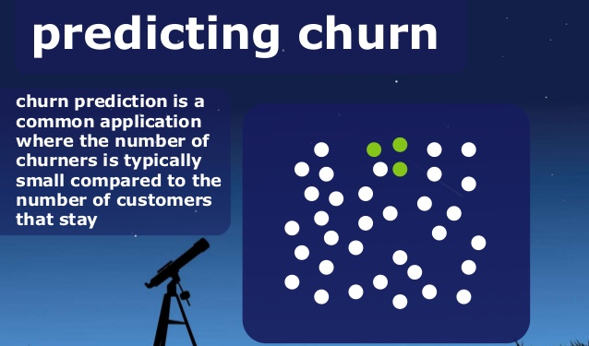
What Is Churn/Attrition ?
When your customers reduce their usage or completely stop using your products or services
They are leaving your brand and might be shopping with your competitor

Slide 16
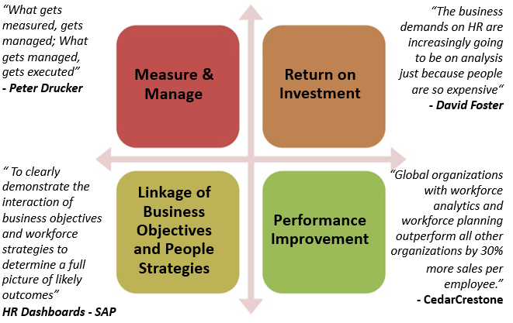
Why HR needs Analytics

Slide 17

Why HR needs Analytics
Predict attrition especially amongst high performers.
Forecast the right fitment for aspiring employee
Predict how compensation values will pan out.
Establish
linkages between Employee engagement score and C-Sat scores(Work in progress)

Slide 18
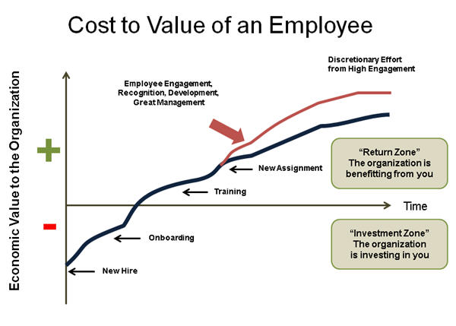
Impact of Employee Turnover

Slide 19
Cost of Employee Turnover
A CAP study found average costs to replace an employee are :
16% of annual salary for low-paying jobs (earning under $30,000 a year).
For example, the cost to replace a $10/hour retail employee would be $3,328.
20% of annual salary for mid-range positions (earning $30,000 to $50,000 a year).
For example, the cost to replace a $40k manager would be $8,000.
Up to 213% of annual salary for highly educated executive positions.
For example, the cost to replace a $100k CEO is $213,000.
Hard to predict the true cost of employee turnover as there are many intangible, and often untracked, costs associated with employee turnover

Slide 20
Real Cost Of Losing An Employee?
In a recent article on employee retention, Josh Bersin of Bersin by Deloitte outlined factors a business should consider in calculating the "real" cost of losing an employee.
These factors include:
The cost of hiring a new employee including the advertising, interviewing, screening, and hiring.
Cost of on-boarding a new person including training and management time.
Lost productivity... it may take a new employee 1-2 years to reach the productivity of an existing person.
Lost engagement... other employees who see high turnover tend to disengage and lose productivity.
Customer service and errors, for example new employees take longer and are often less adept at solving problems.
Training cost. For example, over 2-3 years a business likely invests 10-20% of an employee's salary or more in training
Cultural impact... Whenever someone leaves others take time to ask "why?"

Slide 21
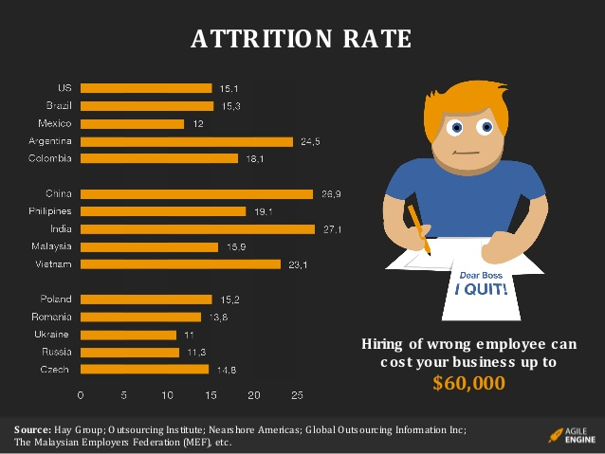
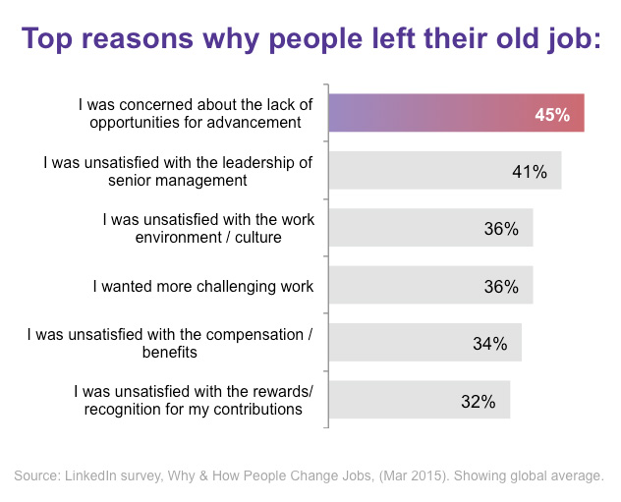
Why Employee look for a change

Slide 22
What we can do about it
Analyze the following traits :
Action Plan To Combat :
Research :
Salary is low
Manager is not able to handle
Check if the environment has become hostile
Segmentation :
Divide you employees in categories like top performers
Monitor each segment trend
Predictive modeling :
Which employees are like to churn
Which employees are the most profitable
Proactive retention strategies:
Use your insights to re-engage your employee
Promise to sort the things
Conduct regular surveys and feedback
Identify :
Which type of employees are churning
Evaluate :
What is the churn rate
Measure:
What is the financial loss
Monitor :
How is it trending
Use Analytical Tools & strategies to combat Attrition

Slide 23
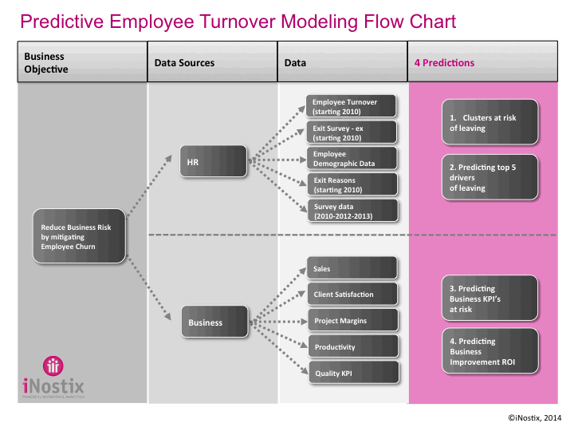
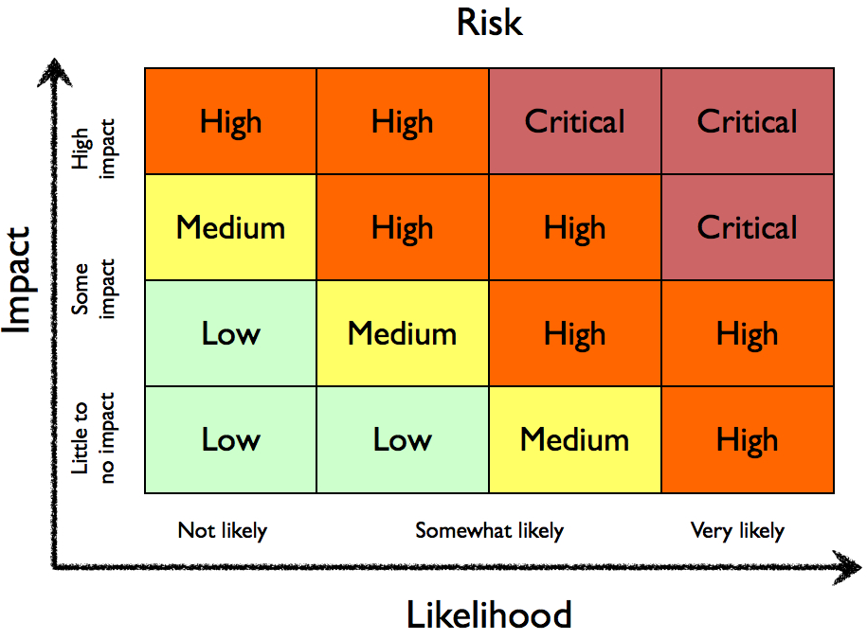

Build Retention Framework
Build an attrition model
Build a profitability model
Build a cross model with above two models

Slide 24
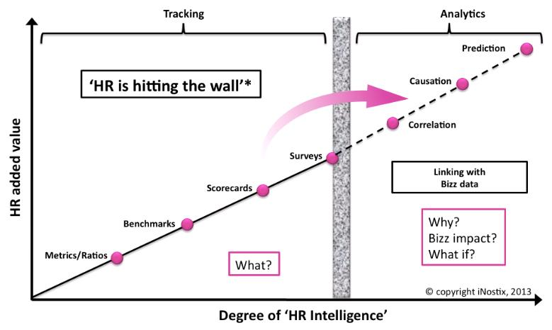
Smart HR Analytics can foresee the churn
If HR Analyses the employee data beyond the wall, they can gain more insights from it and hence can stop turnover before it gets triggered

Slide 25
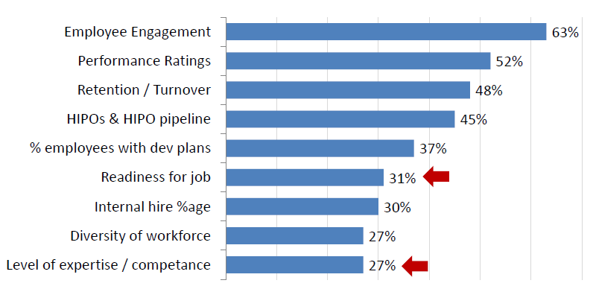
What Is Measured Normally By HR
HR generally concentrate on the following factors :

Slide 26
What can be measured by predictive analysis
Apart from the previous factors, an HR should pay attention to :
Recruitment
Organization
Retention
effectiveness
HR
Matrices
Performance &
Workforce
Career
Management
Comp &
Training
Benefits

Slide 27
Critical Area For predictive analysis
Turnover modeling :
Predicting future turnover in business units in specific functions, geographies by looking at factors such as commute time, time since last role change, and performance over time.
2.Targeted retention :
Find out high risk of churn in the future and focus retention activities on critical few people
3.Risk Management :
Profiling of candidates with higher risk of leaving prematurely or those performing below standard.
4.Talent Forecasting :
To predict which new hires, based on their profile, are likely to be high fliers and then moving them in to fast track programs

Slide 28
Common HR mistakes to avoid
1. Keeping a metric live even when it has no clear business reason for being

Slide 29
Common HR mistakes to avoid
1. Keeping a metric live even when it has no clear business reason for being
2. Relying on just a few metrics to evaluate employee performance, so smart employees can game the system

Slide 30
Common HR mistakes to avoid
1. Keeping a metric live even when it has no clear business reason for being
2. Relying on just a few metrics to evaluate employee performance, so smart employees can game the system
3. Insisting on 100% accurate data before an analysis is accepted—which amounts to never making a decision

Slide 31
Common HR mistakes to avoid
1. Keeping a metric live even when it has no clear business reason for being
2. Relying on just a few metrics to evaluate employee performance, so smart employees can game the system
3. Insisting on 100% accurate data before an analysis is accepted—which amounts to never making a decision
4. Assessing employees only on simple measures such as grades and test scores, which often fail to accurately predict success

Slide 32
Common HR mistakes to avoid
1. Keeping a metric live even when it has no clear business reason for being
2. Relying on just a few metrics to evaluate employee performance, so smart employees can game the system
3. Insisting on 100% accurate data before an analysis is accepted—which amounts to never making a decision
4. Assessing employees only on simple measures such as grades and test scores, which often fail to accurately predict success
5. Using analytics to hire lower-level people but not when assessing senior management

Slide 33
Common HR mistakes to avoid
1. Keeping a metric live even when it has no clear business reason for being
2. Relying on just a few metrics to evaluate employee performance, so smart employees can game the system
3. Insisting on 100% accurate data before an analysis is accepted—which amounts to never making a decision
4. Assessing employees only on simple measures such as grades and test scores, which often fail to accurately predict success
6. Analyzing HR efficiency metrics only, while failing to address the impact of talent management on business performance
5. Using analytics to hire lower-level people but not when assessing senior management

Slide 34



Predictive Analytics Is A Game-Changer
Can precisely identify the value of a 0.1% increase in employee engagement among employees at a particular store.
At Best Buy, for example, that value is more than $100,000 in the store’s annual operating income.
Source: Forbes

Slide 35


Predictive Analytics Is A Game-Changer
Many companies favor job candidates with stellar academic records from prestigious schools—but
AT&T and Google have established through quantitative analysis that a demonstrated ability to take initiative is a far better predictor of high performance on the job.

Slide 36


Predictive Analytics Is A Game-Changer
Sprint has identified the factors that best foretell which employees will leave after a relatively short time
In 3 weeks Oracle was able to predict which top performers were predicted to leave the organization and why - this information is now driving global policy changes in retaining key performers and has provided the approved business case to expand the scope to predicting high performer flight

Slide 37
Advanced And Predictive Analytics Application
Problem statement:
An Indian MNC has a linear growth model. It wants to identify relationship between % revenue growth and % headcount growth. They have revenue and headcount details for past 10 years. Solution
Solution Approach:
•Identify the correlation coefficient based on the type of data and plot a scatter plot.
•Given that revenue growth is estimated at X% for the next year, we can predict headcount growth
Problem statement:
An HR manager identify 20 variables such as educational qualification, college, age, gender, nationality etc. that predicts the hiring effectiveness. He wants to identify mutually exclusive variables which affect hiring effectiveness.
Solution Approach:
•Using factor analysis , mutually exclusive factors can be identified

Slide 38
Advanced and Predictive Analytics application
Problem statement:
Campus hiring team is interested in how variables, such as entrance test score conducted by company, GPA (grade point average) and prestige of the institution, effect selection . The response variable, selected/not selected, is a binary variable
Solution Approach:
•Selection data is collected for past 5 years for the above parameters indicated.
•Here dependent variable is selected/not selected( Selected =1, Not Selected= 0) and independent variables are Test Score, GPA, Prestige of the institute.
•Using logistic regression a equation can be developed
Problem statement:
A company conducted a employee engagement survey using a questionnaire developed by internal HR team. The questionnaire had 15 questions and responses were collected from 50 employees. As a HR manager, we want to identify mutually exclusive factors.
Solution Approach:
•Using factor analysis , mutually exclusive factors can be identified

Slide 40

Key To Success
Develop culture of data-driven decision-making

Slide 41
Key To Success
Transparency of business and workforce information
Develop culture of data-driven decision-making

Slide 42
Key To Success
Transparency of business and workforce information
Develop culture of data-driven decision-making
Empower line leaders, not just HR and L&D

Slide 43
Key To Success
Transparency of business and workforce information
Analytics as a journey, not an end
Develop culture of data-driven decision-making
Empower line leaders, not just HR and L&D

Slide 45
Survey

